Slide 1
Rotting Research: How Link Rot Impacts the Integrity of Scholarly Publishing
Dr. Marshal A. Miller

Slide 2
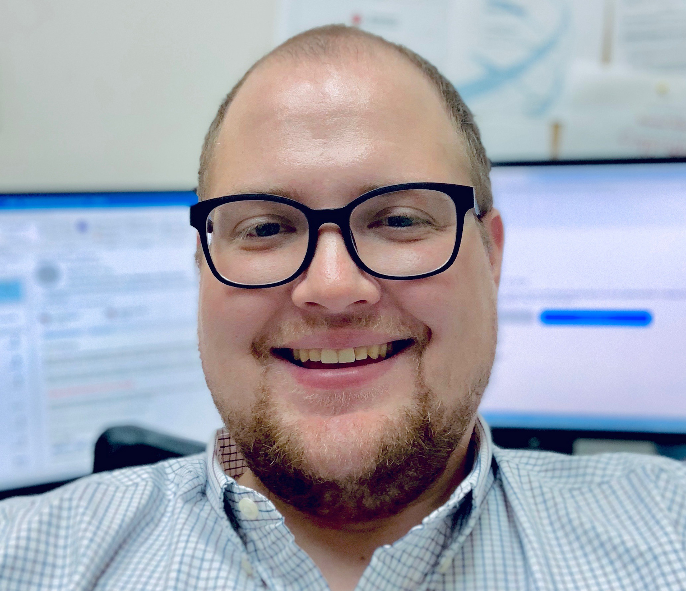
About Me
Dr. Marshal A. Miller
Assistant Professor
Computer & Information Science
Northampton Community College

Slide 3
Learning Objectives
By the end of this presentation, you will be able to:
Define link rot.
Describe the effect of link rot on scholarly research.
Discuss potential remediations.

Slide 4
What is Link Rot?
Link rot: The phenomenon of resources becoming inaccessible over time when their originally cited location is relocated or becomes permanently unavailable.

Slide 5
How Bad is It?
Krol and Zdonek claimed over 70% of internet addresses cited in articles published in the Harvard Law Review failed to navigate to the original content.
The authors noted that even the Supreme Court has been affected, with only about 50% of links in their decisions leading to the content intended.

Slide 6
How Does This Affect Research?
Link rot severely affects academics, who rely heavily on previous research.
Replication of studies is difficult, or impossible, without the ability to find reference resources.
Loss of verification calls into question the validity of literature reviews.
Research has previously focused on individual disciplines.
A pilot study was conducted on an institutional repository.

Slide 7
How Does This Affect Research?
West et al. (2017) asserted that link rot has severe consequences for academics who rely
heavily on previous research. The authors added replication is difficult, if not impossible,
without the ability of researchers to find needed resources. The loss of research citations also
calls into question the validity of literature reviews in scholarly publications (Rubbo et al., 2019).
Although researchers have investigated this topic in individual disciplines, few have compared
the effects of link rot across disciplines (Aksnes et al., 2019).

Slide 8
How Does This Affect Research?
Citations tend to decay over time because of a preference for recentness, even over
seminal works (Gerow et al., 2018). Krol and Zdonek (2020) found that only 30% of links in the sciences functioned after 4 years.
Abt (2018) claimed no one
but Zwicky cited the study for 27 years and added that it was not seriously discussed for a total
of 41 years after its publication.
According to Krol and Zdonek, a
review of the Web of Science citation index showed that the average lifespan for a resource’s
website was 9.3 years. Unfortunately, only 62% of that data was archived.
References do, however, provide a method for
others to retrace the steps a researcher took to establish their position (Penders, 2018).

Slide 9
How Does This Affect Research?
Overall percentage of broken links was 36%.
Fell short of the 50% threshold.
Results aligned with previous studies from Król and Zdonek (2020), Rivkin (2020), and Genzinger and Wills (2017).

Slide 10
How Does This Affect Research?
Retracted Publications

Slide 11
But We Have DOIs
37% of DOI links were broken.
Klein and Balakireva (2021) showed 33% of DOI links to be broken on one institution’s internal network.
Klein and Balakireva found 51.7% of DOIs were unreachable from outside of the institution’s network.

Slide 12
Rotting Research: The Study
2,500 peer-reviewed scholarly articles.
Published between 2013 and 2022. 250 publications per year.
500 publications from each of the 5 disciplines:
Arts & Humanities
Business
Health and Medicine
Science, Math, and Technology
Social Sciences

Slide 13
Other Findings
Mean of broken links by academic domain.
Arts & Humanities – 39%
Business – 39%
Health & Medicine – 32%
Science, Math, & Technology – 34%
Social Sciences – 37%
Some publishers have developed independent policies to address DOI longevity.
Homenda (2021) asserted the best link to use is the one most likely to provide continual access to the resource.
However, some publishers have pointed their DOIs to pages behind a paywall without providing any means of checking the link besides logging in.
This situation returns an HTTP response code in the 300s.
Publishers have also compromised the integrity of DOI links by using a third-party service to handle their DOIs.
Crossref serves as one example that frequently appeared in 300-level response codes.
Using a third-party service adds another possible point of weakness in the process.

Slide 14
Other Findings
One possible factor contributing to these percentage differences involves the use of different style guides.
As outlined in Chapter 2, style guides vary by discipline and, occasionally, by the institution.
Additionally, some study guides have changed more frequently than others, and some still contain outdated information in their most recent versions.

Slide 15
Other Findings
ArXiv is unique because it does not just collect the metadata for a publication; it also acts as a repository for the publication itself.
ArXiv can do this by limiting their publications to only those that are open access.
The benefit of this method is that arXiv controls the publication’s location, enabling them to ensure the reference remains up-to-date.

Slide 16
Rotting Research: The Project

Slide 17
Rotting Research: The Plan

Slide 18
Rotting Research: The Conversation
Content Drift

Slide 19
Resources

Slide 20
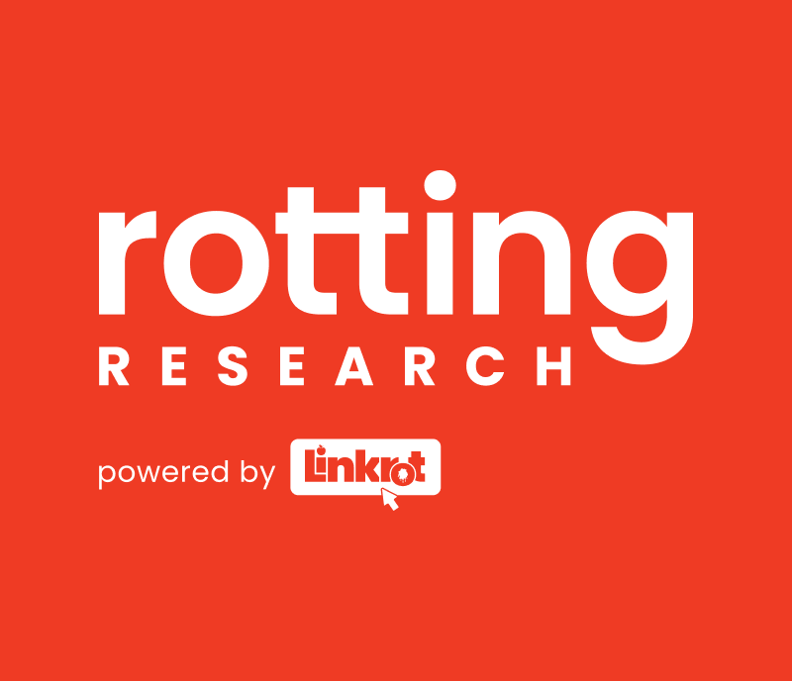
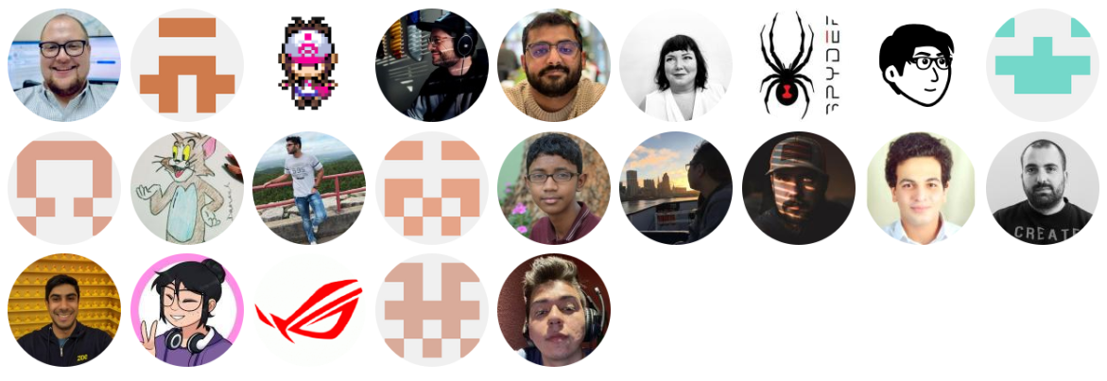
Contributors
https://rottingresearch.org

Slide 21

Leave Feedback
https://app.keysurvey.com/f/41693657/5c14/

